Slide 1
Assignment 2
Implement and test placeholder replacement logic
Team B

Slide 2
Problem Statement
Objective: Implement and test placeholder replacement logic.
• Tasks:
o Ensure multiple placeholders are correctly replaced.
O Handle scenarios where placeholders are not found.
O Test scenarios:
1. Multiple Placeholders
2. Placeholder Not Found

Slide 3
Program
import java.util.Scanner;
public class PlaceholderReplacer {
public static void main(String[] args) {
Scanner scanner = new Scanner(System.in);
String template = "Connecting to server {hostname} at IP address {ip}.";

Slide 4
// First Test Case: User provides both hostname and IP address
System.out.println("Test Case 1:");
System.out.print("Enter hostname: ");
String hostname1 = scanner.nextLine();
System.out.print("Enter IP address: ");
String ip1 = scanner.nextLine();
String result1 = template.replace("{hostname}", hostname1).replace("{ip}", ip1);
System.out.println("Output: " + result1 + "\n");

Slide 5
// Second Test Case: User provides only hostname, IP address is missing
System.out.println("Test Case 2:");
System.out.print("Enter hostname: ");
String hostname2 = scanner.nextLine();
String result2 = template.replace("{hostname}", hostname2).replace("{ip}", "{ip}");
System.out.println("Output: " + result2 + "\n");

Slide 6
// Third Test Case: User provides only IP address, hostname is missing
System.out.println("Test Case 3:");
System.out.print("Enter IP address: ");
String ip3 = scanner.nextLine();
String result3 = template.replace("{hostname}", "{hostname}").replace("{ip}", ip3);
System.out.println("Output: " + result3 + "\n");

Slide 7
// Fourth Test Case: Neither hostname nor IP address is provided
System.out.println("Test Case 4:");
String result4 = template.replace("{hostname}", "{hostname}").replace("{ip}", "{ip}");
System.out.println("Output: " + result4 + "\n");
}
}

Slide 8
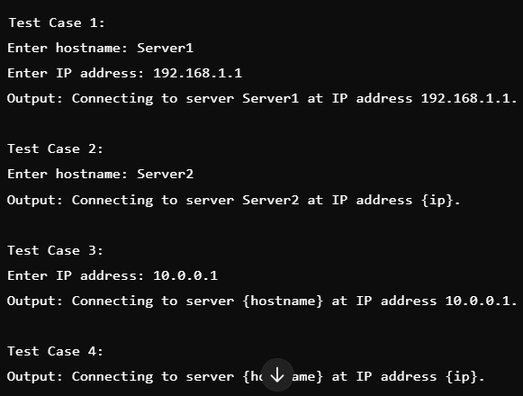
Output

